Slide 1
PERSONALIZED AND OVERSIMPLIFIED QUICK DECISION MAKER FOR TIP MODE OF TRANSPORTATION
Sumilang, Kenneth
Delloson, Renz

Slide 2
PROBLEM DISCUSSION
Navigating daily transportation decisions can be daunting, especially for students balancing tight schedules and limited budgets. The problem becomes even more pronounced when a student wakes up and struggles to rationalize the best mode of transportation to get to their first class on time. This scenario necessitates a personalized decision-making tool that considers various factors such as the time of the first class, the student’s budget, and the current time, to recommend the most optimal mode of transportation.

Slide 3
SOLUTION Develop a Python program that assists university students in selecting the best mode of transportation each day.

Slide 4
LIMITATIONS
The values of certain routes are based on personal estimations as it was not feasible to data scrape Google Maps traffic data on certain routes. For one, acquiring the Directions API require one to have a credit card. We do not possess a credit card so accurately defining weights relative to time is futile.

Slide 5
CONSTRAINTS
The program will analyze two factors:
Budget: The maximum allowable spending on a transportation option
Time: The time window between the current time and the target time defines the allowable travel duration for selecting a viable transportation option.

Slide 6
GRAPH
Taxi
5 mins
Grab
20-30 mins
20-30 min
1 min
Home
Timog Ave.
Anonas
T.I.P
3 mins
25-30 min
5 min
5 mins
Angkas
15-20 mins

Slide 7
TIME AND TRAFFIC
Traffic and time are correlated as the earlier the time is, the less traffic certain graphs weigh. Here is a table that determines when certain nodes change values based on time.
Current Time | Certain Nodes | Travel Time
4 am – 9 am | Taxi | 15
4 am – 9 am | Motorcycle | 15
4 am – 9 am | Timog Ave (Jeep) | 15
4 am – 9 am | Grab | 15
9:01 am- 6pm | Taxi | 30
9:01 am- 6pm | Motorcycle | 25
9:01 am- 6pm | Timog Ave (Jeep) | 45
9:01 am- 6pm | Grab | 30

Slide 8

PRIORITIES BASED ON CONSTRAINTS
Being on time: will recommend path that will bring one to the destination the fastest. Cannot be late.
Budget: if the fastest route is too expensive, it will loop to other options until the budget fits.
If both are positive: the route that brings out the most value will be prescribed. It is based on 2 formulas
Budget Fit Score= 1- $\frac{Cost}{Budget}$
Value Score=$\frac{1−(\frac{Cost}{Budget})}{Travel Time}$

Slide 9
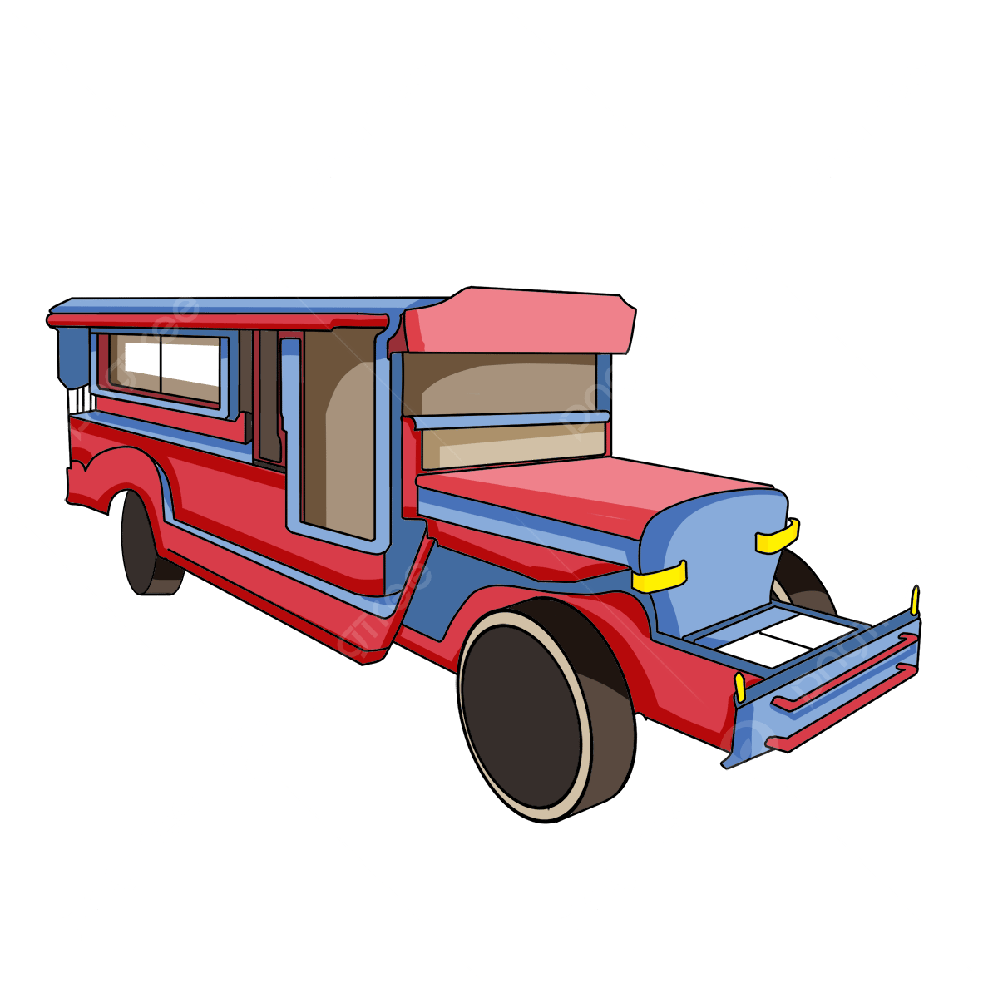
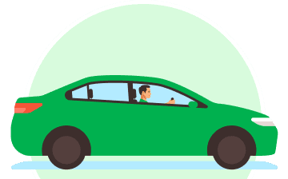
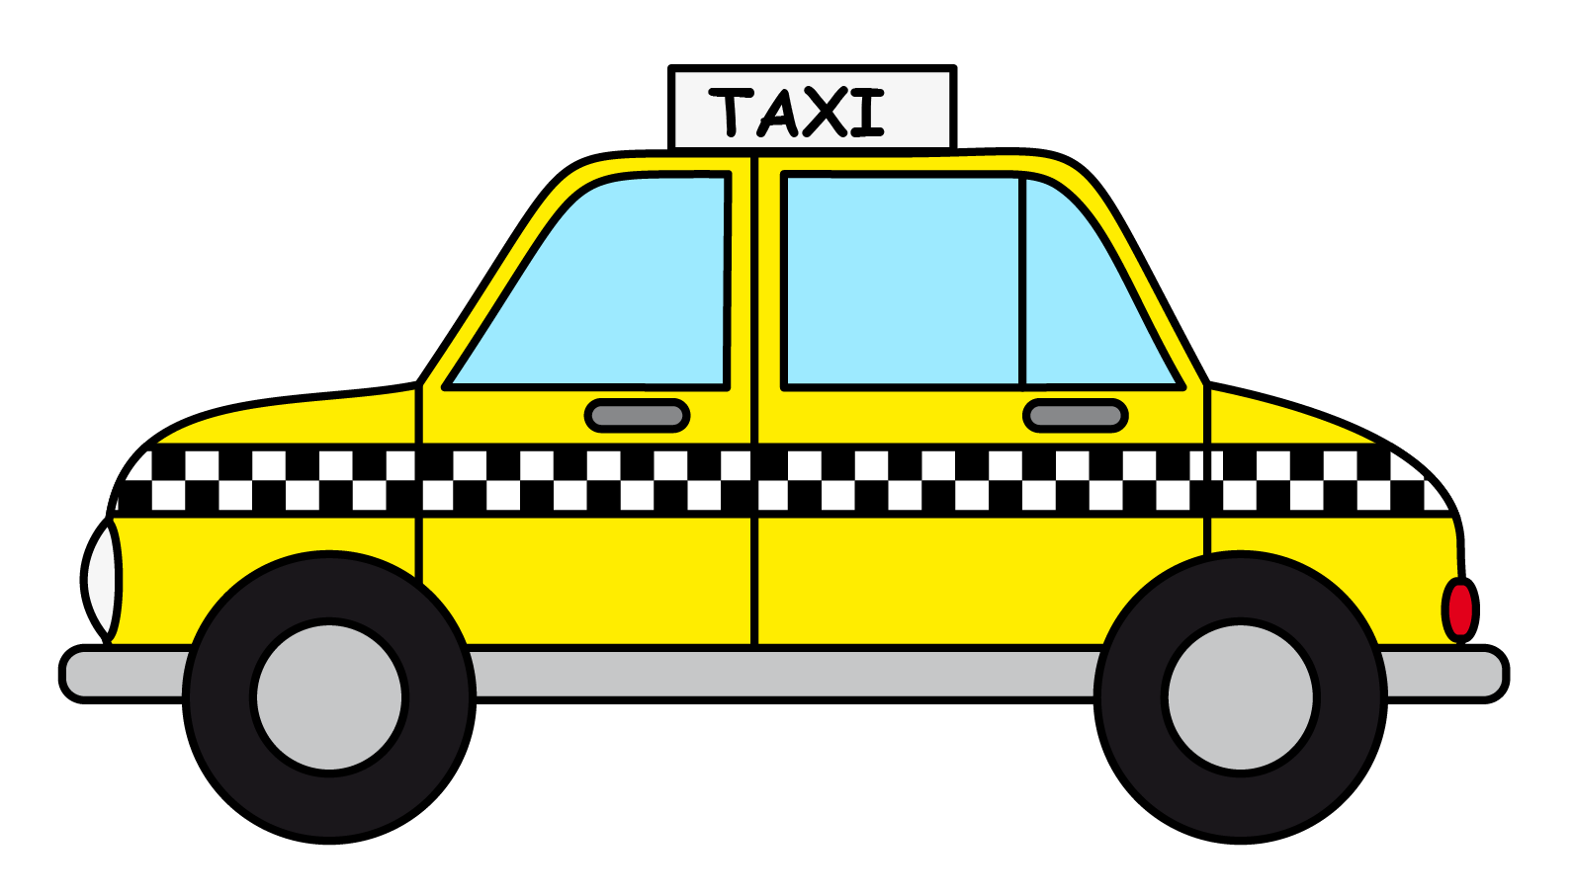
EXAMPLE
IF BUDGET IS 300 PESOS:
Option | Travel Time (Minutes) | Cost | Budget Fit Score | Value Score
Taxi | 25 minutes | 120 pesos | 0.6 | 0.024
Timog Ave. (Jeep) | 30 minutes | 11 pesos | 0.9633 | 0.0321
Grab | 20 minutes | 275 pesos | 0.0833 | 0.0042
Angkas | 15 minutes | 100 pesos | 0.6667 | 0.0444

Slide 10
ITERATION 1
Decomposition
- Identify different transportation options.
- Determine the travel time for each option.
- Check if each option meets the target time.
Problem Identification
Determine best route to reach destination on time with budget constraints and decision value in consideration
Pattern Recognition
- If an option does not meet the target time, discard
Abstraction
Relevant information: transportation options, travel time, cost.
Less relevant information: specific routes or non-critical stops.

Slide 11
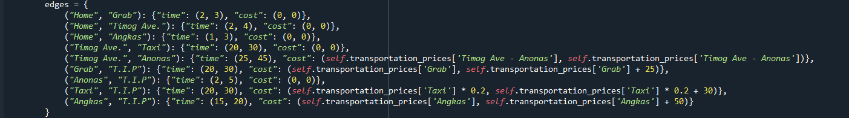
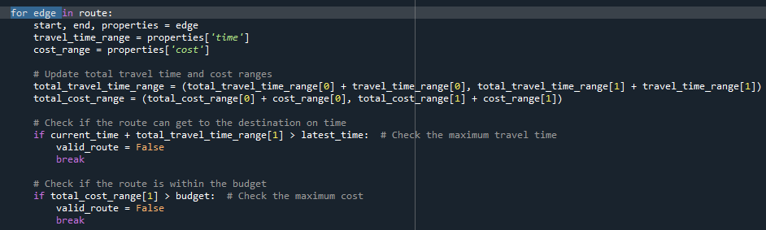
- Identify different transportation options. - Determine the travel time for each option. - Check if each option meets the target time.
DECOMPOSITION

Slide 12
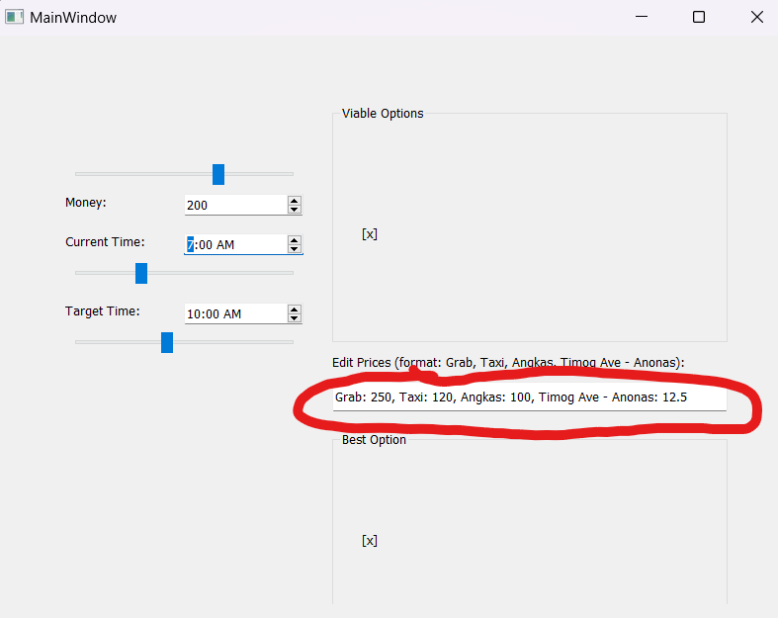


Pattern Recognition
Abstraction
-if an option does not meet the target time, discard

Slide 13
ITERATION 2
Decomposition
Check the cost of each transportation option.
Discard options that exceed the budget.
Calculate the Budget Fit Score for each option.
Problem Identification
How can we ensure that the selected transportation option is within budget while providing the best value?
Pattern Recognition
- If an option does not meet the target time, discard
Abstraction
Relevant information: transportation options, travel time, cost.
Less relevant information: specific routes or non-critical stops.

Slide 14
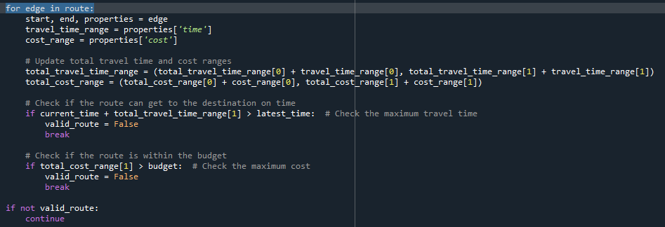

DECOMPOSITION
Check the cost of each transportation option.
Discard options that exceed the budget.
Calculate the Budget Fit Score for each option.

Slide 15
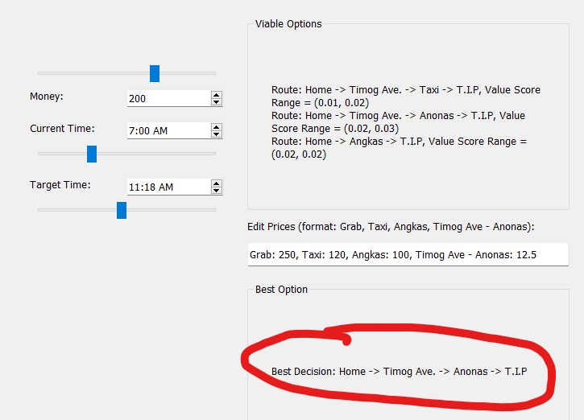
Pattern Recognition
Abstraction
- If an option does not meet the target time, discard

Slide 16
Decomposition
Calculate the Value Score for each option using the Budget Fit Score and travel time.
Store and compare the Value Scores.
Select the option with the highest Value Score.
ITERATION 3
Problem Identification
Calculate Value Score to Determine the best route
Pattern Recognition
-The option with the highest Value Score is the best decision.
Abstraction
Relevant information: transportation options, travel time, cost, budget, Value Scores.
Less relevant information: minor variations in travel time (e.g., due to traffic).

Slide 17

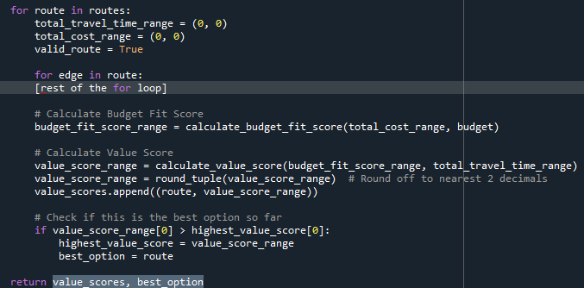
DECOMPOSITION
Calculate the Value Score for each option using the Budget Fit Score and travel time.
Store and compare the Value Scores.
Select the option with the highest Value Score.

Slide 18
THE BIG PICTURE
Input
Processing
Output
Check Timeliness, Budget, Value Scores
Current Time
Viable Decisions
Target Time
Best Decisions

Slide 19
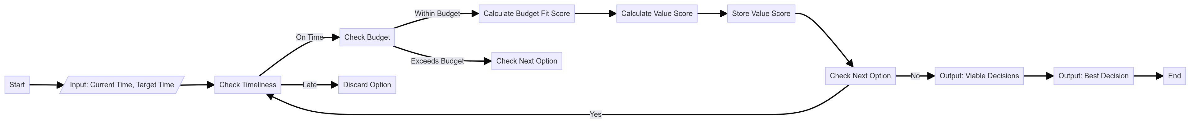
FLOWCHART

